Slide 1
Content-worth debut artist classifier
Wonyoung Lucas Seo

Slide 2
Introduction

Slide 3
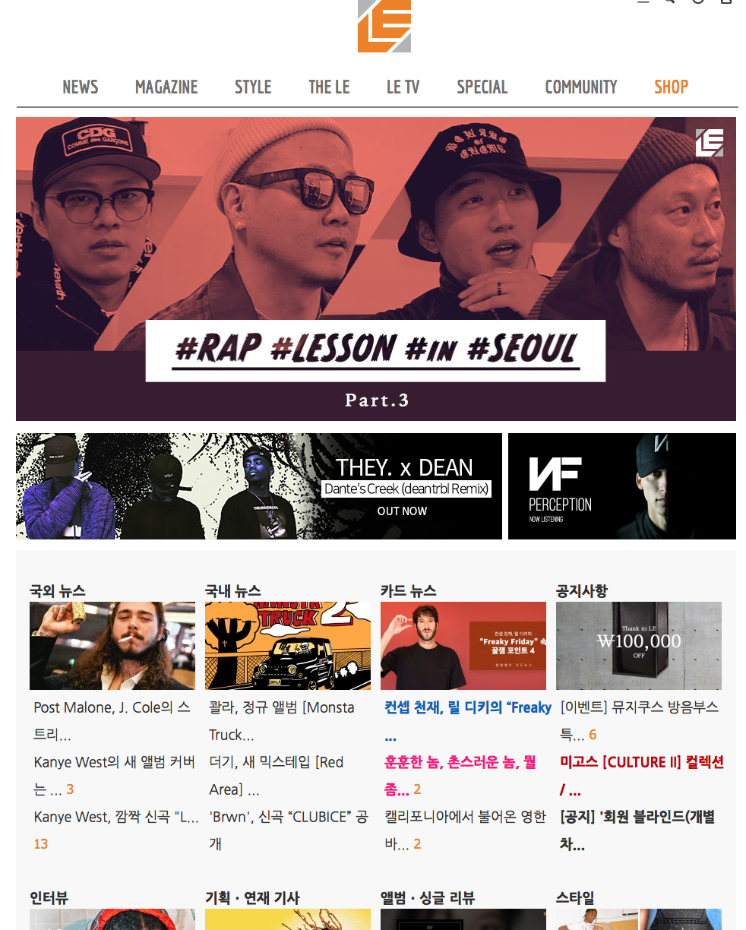
HIPHOPLE.com ??????????
US HIPHOP/R&B based Web Magazine platform
Major Contents
Translation
Lyric Translation( * this is the part I contribute )
Subtitled Music Video
News of HIPHOP / R&B Industry
Magazine
Feature Articles
Artist Interview
Album Review
Fashion / Life Style

Slide 4
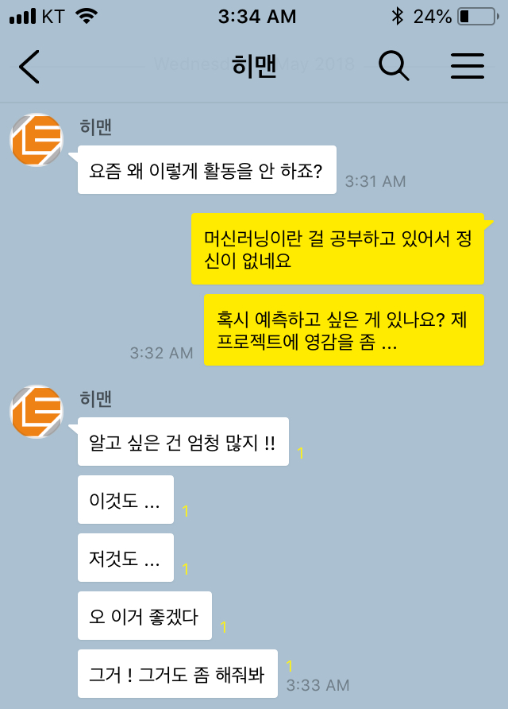
Project Inspiration
( CEO )
Why don’t I see you
working these days?
CEO’s needs
Public reputation / preference analysis for merchandise sales
K-Hiphop buzz analysis in South-East Asian region media
Super Rookie Artist prediction analysis
Messenger app chatbot
And many more …
I’ve been totally occupied with this machine learning thing
Do you have anything in mind that you want to predict or analyze ?
I need some inspiration for my project
Actually, I do !!
This …
And that …
This would be awesome
Yeah and that too …

Slide 5
Predict Super Rookie ?? ( … sounds cool. Maybe I should first focus on this one)

Slide 6
Setting More Specific Goal …
Hiphople Magazine Team produces contents of successful debut artists
Let’s predict Super Rookie!!!
When producing contents on a debut artist … :
Based on the domain/industrial knowledge , editors decide whether or not to produce a content on thie particular rookie artist.
Spend considerable amount of time to research them.
Or loose chance to become the first press to write about the aritst to other press.
Let’s predict whether the rookie artist
is worth creating a content & publish /
distribute to our subscribers with Machine
Learning classification technique based on
the quantitative information
How can we reduce research time by assigning priority list?
&
Improve decision making process?

Slide 7
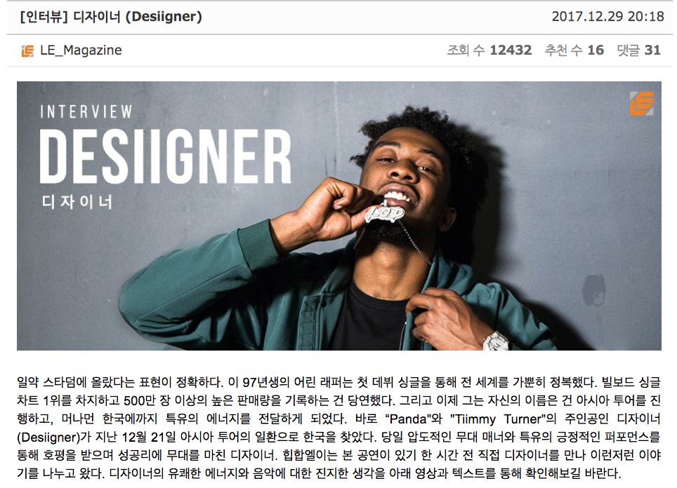
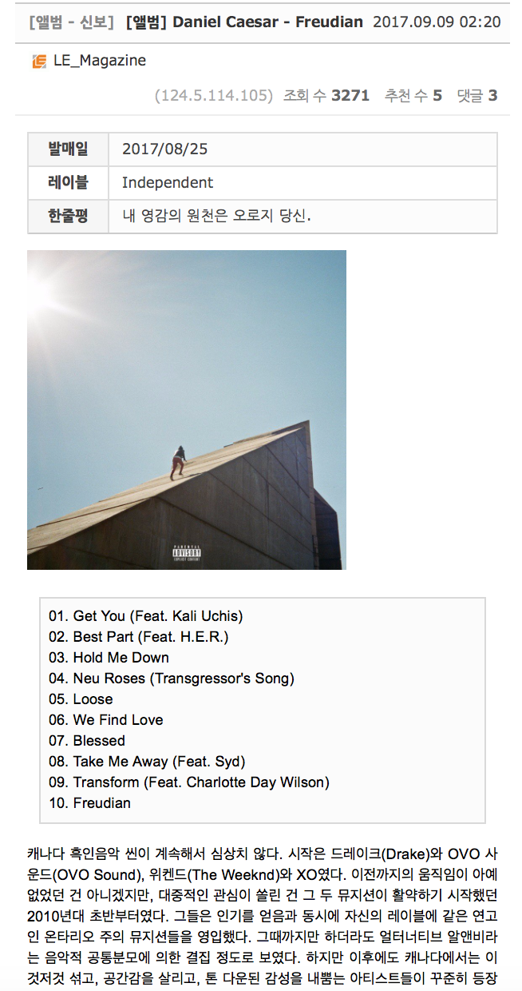
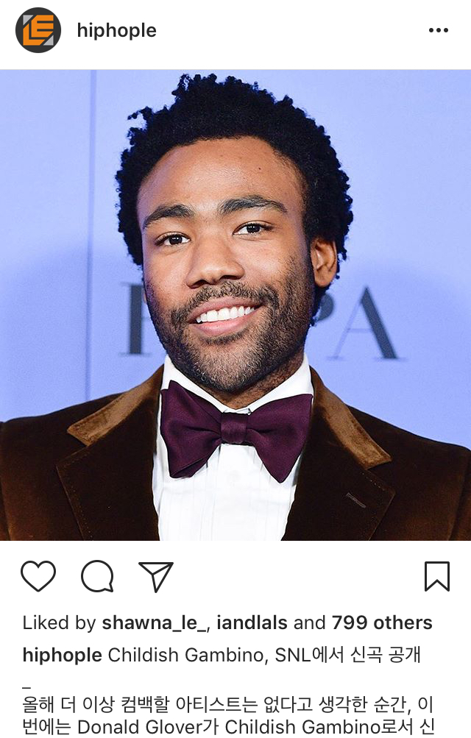
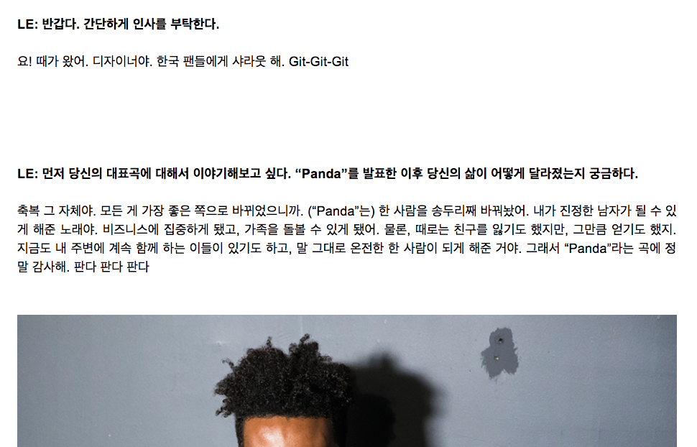
HIPHOPLE’s contents =
Review + Interview + Feature Articles + SNS Account + @

Slide 8
Project workflow

Slide 9
Define Variables / Input
Collect Data & Store AWS MySQL DB Server
Labeling Target Variable Classes
ORM Data Query
Merging Data
Fitting Models
Feature Engineering
Model Cross Validation and Optimization

Slide 10
Define variables / input

Slide 11
Target Variable
Binary Classification
1 : Worth-creating a content with this artist
0 : Ignore this artist
→
HIPHOPLE editors
participated in labeling process based on their domain knowledge

Slide 12
Independent Variables (Features, Input)
Rows : Debut Album released from Jan 1st 2011 to Apr 18th 2018
- Genre
- Count of single album released before the official album release
- Count of articles published by Music / Culture Media Press
- Ratings from Music Media Press
- Number of SNS followers of each artist

Slide 13
Collecting data (crawling)

Slide 14
Data Crawling → Stored in AWS EC2 MySQL DB
Crawling Data | Crawling Target | Crawling Python Library
Debut album by year | www.wikipedia.com | Requests, BeautifulSoup
Ratings | www.metacritic.com | Scrapy
 | www.pitchfork.com | Requests
 | www.albumoftheyear.com | Requests, BeautifulSoup
SNS followers of each artist | www.chartmetric.io | Selenium
Count of related article | www.billboard.com | Requests, BeautifulSoup
 | www.genius.com | Requests, BeautifulSoup
 | www.thesource.com | Requests, BeautifulSoup
 | www.xxlmag.com | Requests, BeautifulSoup

Slide 15
Target Variable Class Labeling

Slide 16
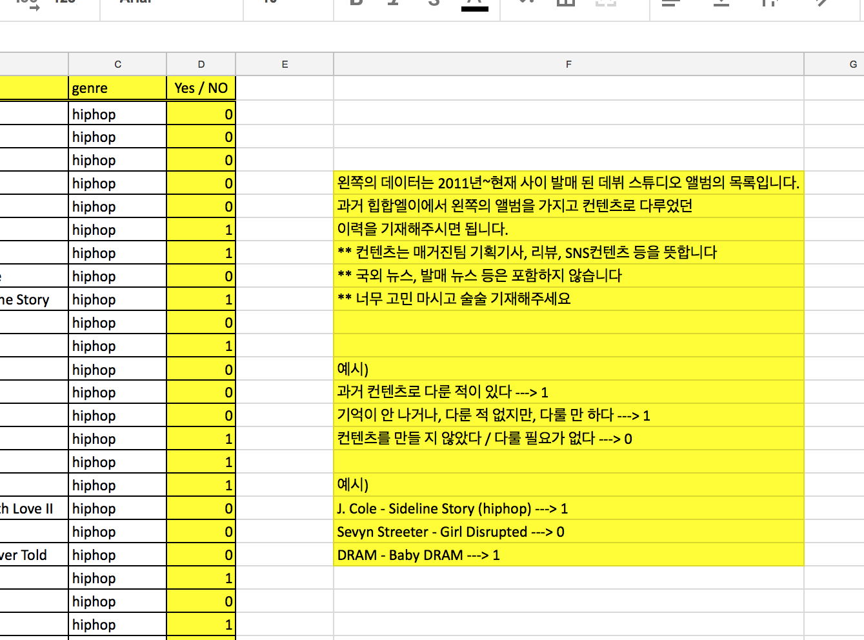
Labeling
Editors participated in labeling the class as 1 , 0
Labeling sheet was shared via Google Spreadsheet
If you had created any contents on this artist/album please label it as “ 1 ” in roman numerals
If you don’t remember but still think its worth creating contents, please label it as “ 1 ”
If you didn’t created any contents related to this artist/album, please label it as “ 0 ”

Slide 17
Merge Data

Slide 18
Data size : 1083 Rows
Label ( Target Variable)
Features : 15
Album Info
Genre
Count of Single Albums
Ratings
Album of the Year
Pitchfork
Metacritic
Aritcle Counts
Billboard
Genius
The Source
XXL Magazine
SNS
Twitter followers
Instagram followers
Facebook page Likes
Youtube Channel subscribers
Soundcloud followers
Spotify followers

Slide 19
Fitting Models

Slide 20
Classification Algorthms: Scikit-Learn Libraries
Model | Classification Metrics (Class 1) |  |  |  | Comment
 | Precision | Recall | F 1 Score | AUC
KNN : K-Nearest Neighbours | 0.79 | 0.43 | 0.55 | 0.83
SGD : Steepest Gradient Decent | 0.31 | 0.92 | 0.46 | 0.66
Decision Tree | 0.62 | 0.65 | 0.63 | 0.86
Random Forest | 0.74 | 0.67 | 0.70 | 0.91 | ★
Gradient Boosting | 0.69 | 0.57 | 0.62 | 0.93
XGBoost : Extra Gradient Boosting | 0.78 | 0.64 | 0.70 | 0.93

Slide 21
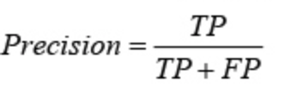
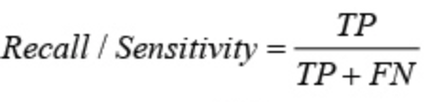
Reason for selecting Random Forest Classifier
Recall (Sensitivity) was major consideration for this project
The impact of False Positive ( FP ) in case of considering Precision
Incorrect prediction : answered Class 1 (prediction) to actual Class 0 data (Real)
Create content even though the artist & album not valued.
Spend more time and energy on incorrect class → Wasted internal resources
The impact of False Negative ( FN ) in case of considering Recall
Incorrect prediction : answered Class 0 (prediction) to actual Class 1 data (Rea)
Ignore the artist & album that we shouldn’t have ignored
Increase possibility of other media creating content first hand
Increase possibility of losing potential subscribers
Increase possibility of losing opportunity of arranging management contract with the artist for management in South Korea

Slide 22
Feature engineering

Slide 23
Feature Engineering Trials
Feature | Type | Descriptions | Performance Improvement
Genre | One-Hot Encoding | Create Dummy Variable with One-Hot Encoding | O
Ratings | Null Value Imputation | Fill in “ 0 ” rating score for the album that didn’t received any ratings | O
Buzz Rating SNS Followers | Binning | Binning the range of numeric values Create Dummy Variables for each bin | X
SNS Followers | Ratio | [ Follower of Each SNS / Total Followers ] Calculate Ratio for each SNS platform | X
SNS Followers | Re-Grouping | Private SNS (Twitter, Instagram) Page & Channel based SNS (Facebook, Youtube) Music based SNS (Soundcloud, Spotify) | X

Slide 24
Improving performance & optimization

Slide 25
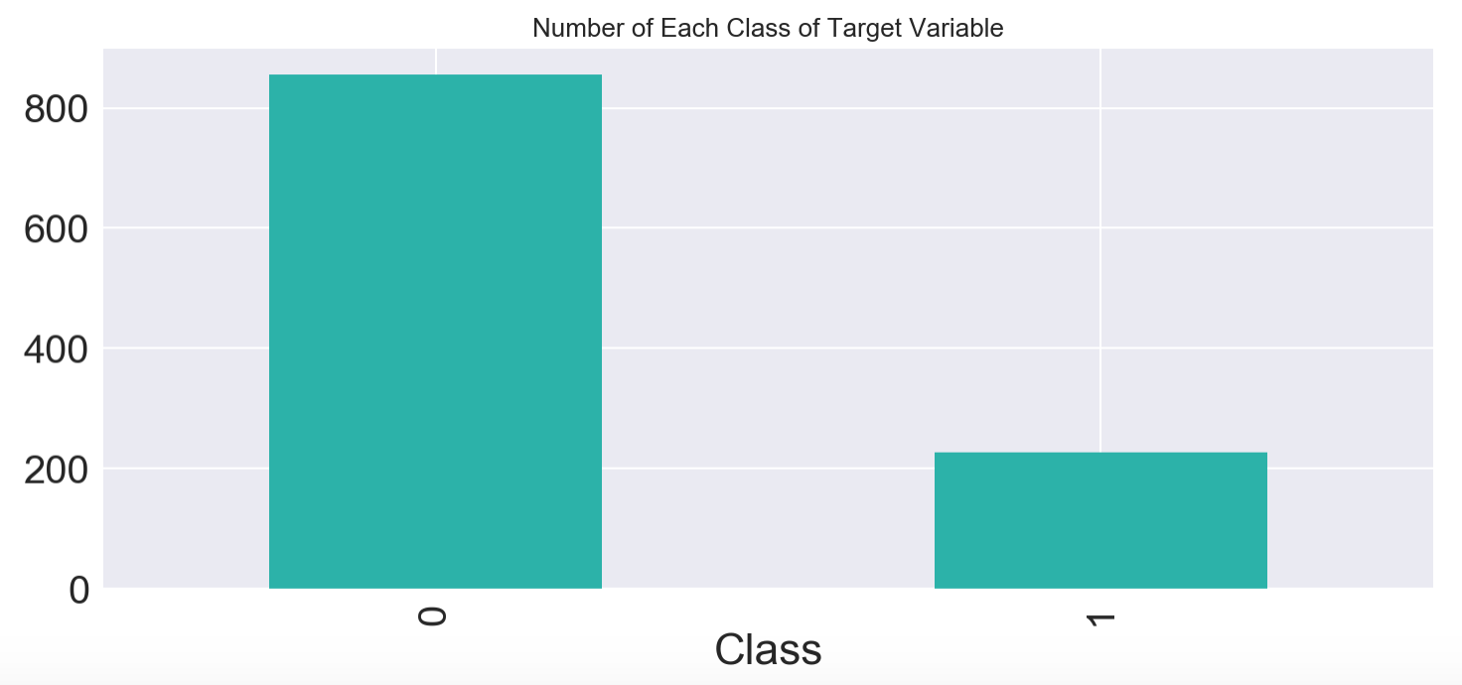
Recall Score Improvement
Imbalance Problem
Number of a Class 1 is far less than Class 0 …
Classifier measures performance based on “Accuracy”
Then Classifier biased towards the major classes and hence show very poor classification rates on minor classes → still shows fairly good accuracy
Applied Under Sampling and adjust Class ratio to 50:50
Trade-off Precision → Focus on Recall Score

Slide 26
Under Sampling : Imblearn Library
Model | Classification Metrics (Class 1) |  |  |  | Comment
 | Precision | Recall | F 1 Score | AUC
ClusterCentroids | 0.45 | 0.95 | 0.61 | 0.86
Random Under Sampler | 0.67 | 0.88 | 0.89 | 0.94 | ★
CondensedNearestNeighbour | 0.61 | 0.80 | 0.69 | 0.92
AllKNN Metrics | 0.54 | 0.89 | 0.67 | 0.92
InstanceHardnessThreshold | 0.60 | 0.89 | 0.72 | 0.92
NearMiss | 0.32 | 0.95 | 0.47 | 0.74
NeighbourhoodCleaningRule | 0.60 | 0.80 | 0.69 | 0.93
OneSidedSelection | 0.76 | 0.73 | 0.75 | 0.92
TomekLinks Metrics | 0.75 | 0.71 | 0.73 | 0.95

Slide 27
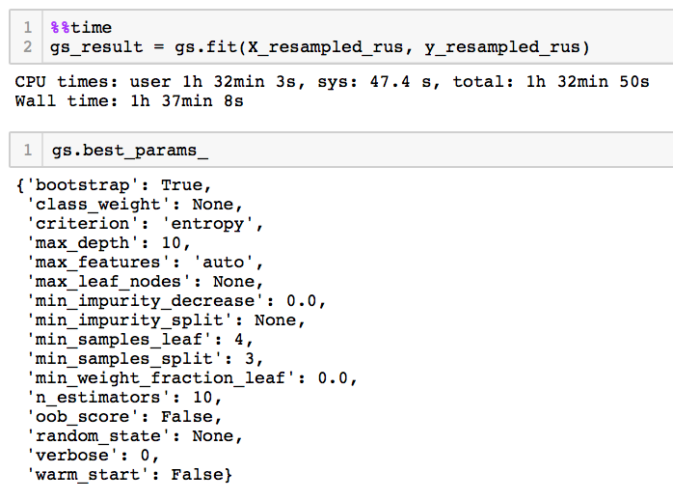
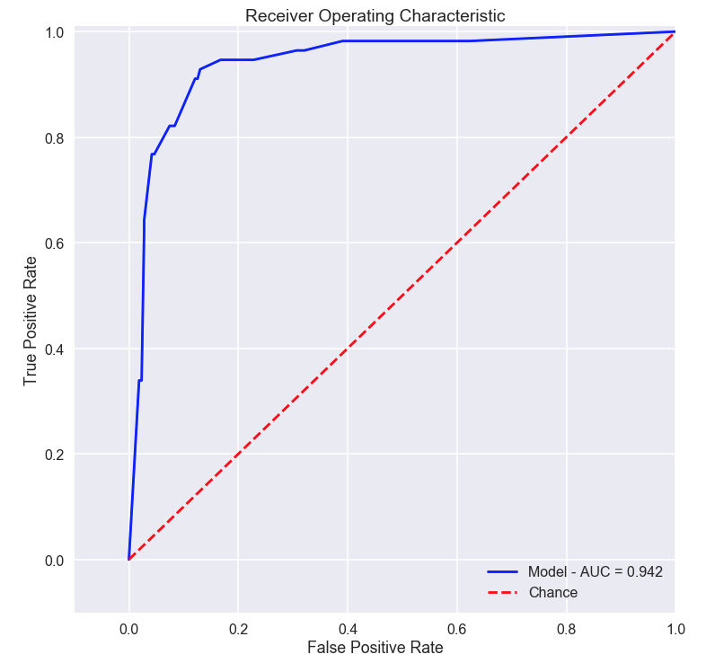
Optimization : Scikit-Learn GridSearchCV
Classification
Report
 | Precision | Recall | F1 Score
Class 0 | 0.98 | 0.87 | 0.92
Class 1 | 0.65 | 0.93 | 0.76
Avg / Total | 0.91 | 0.88 | 0.89
Apply GridSearch Result
Tune Hyper Parameter
ROC Curve
AUC

Slide 28
Test new data !

Slide 29
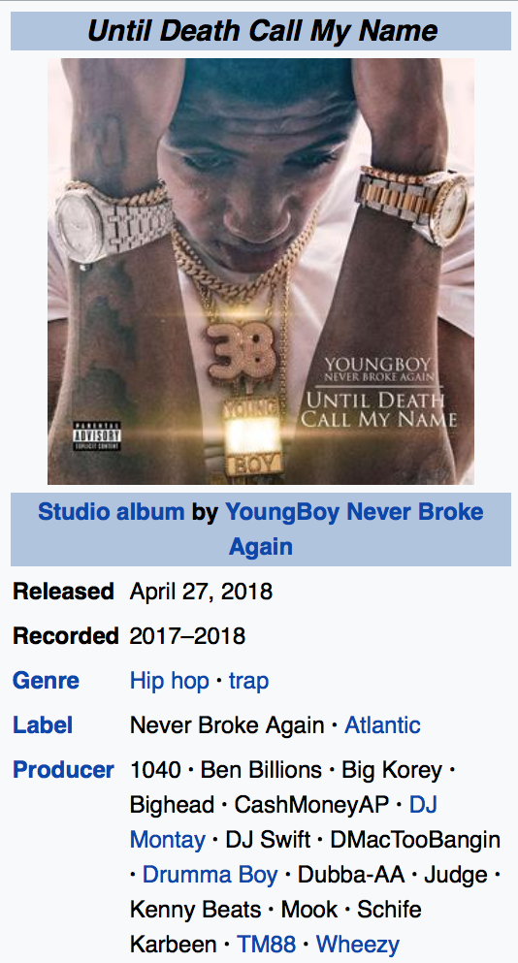
Youngboy Never Broke Again –
Until Death Call My Name
Release date : Apr 27th 2018 (Genre : Hiphop)
Debut Studio Album
* Answer * HIPHOPLE hasn’t produced any contents for this artist and album as of May 9th
Then … how would the model predict on this album?

Slide 30
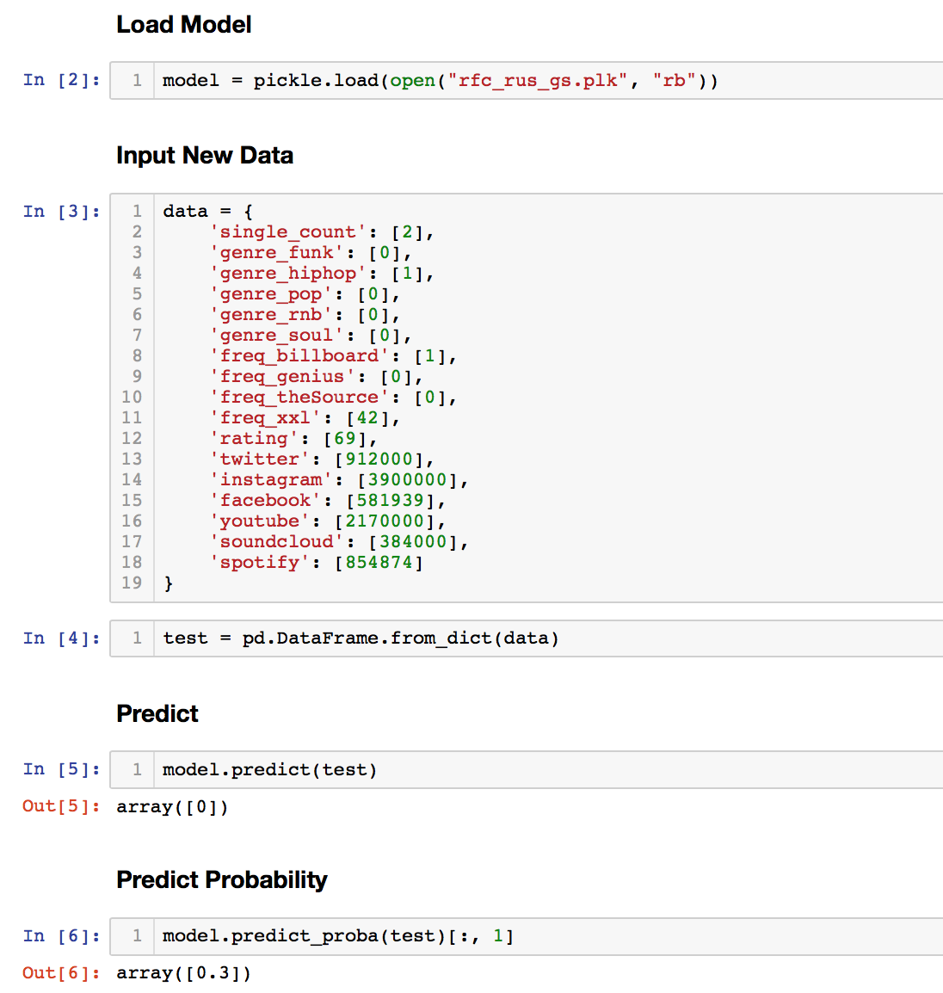
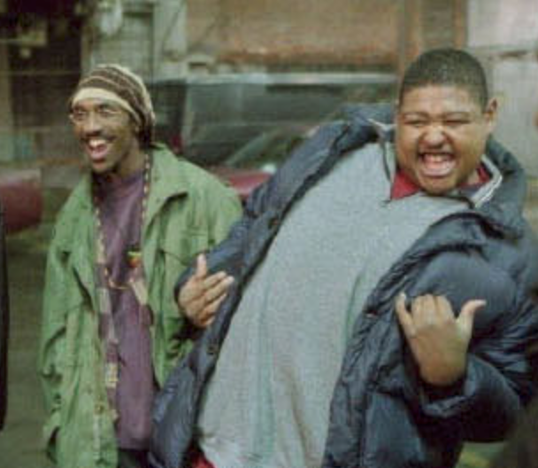
Load Model
Input data from the artist and album
OH - YEAH
Class Predict Result:
0 → Ignore this artist and album
Probability Prediction Result:
30% → Low Probability → Low Priority

Slide 31
How can I improve further?

Slide 32
List of To-Do’s
Research other method to tackle Imbalanced Problem to also increase Precision
Try XGBoost Algorithm and tune its best Hyper Parameter
Small Dataset
Accumulate more data for debut albums in future and reflect on model
Crawl input data from more media press
Text sentiment analysis would be a plus
Dash-based visualization web application
Automation of Crawling Input Data + Prediction
Crawl Feature Data → update dataset
Load Pickle filed model → Predict and return result

Slide 33
For more information on this project …
Please check the links below :D
Github Repository Source Code
https://github.com/lucaseo/content-worth-debut-artist-classification-project
Data Visualization Web Application
http://le-rookie-clf.herokuapp.com
And about me …
Please visit the links below :)
Github
http://www.github.com/lucaseo
LinkedIn
http://www.linkedin.com/in/lucaseo
Github Blog
http://www.lucaseo.github.io

Slide 34
Thank you !

